Slide 1
Setting – up network topology using more than two routers employing static routing

Slide 2
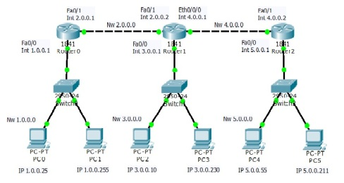

Slide 3
Assign IP address on Router R1:
Router>enable
Router#configure terminal
Enter configuration commands, one per line. End with CNTL/Z.
Router(config)#hostname R1
R1(config)#int fa0/0
R1(config-if)#ip address 1.0.0.1 255.0.0.0
R1(config-if)#no shut
R1(config-if)#exit
R1(config)#int fa0/1
R1(config-if)#ip address 2.0.0.1 255.0.0.0
R1(config-if)#no shut
R1(config-if)#exit

Slide 4
Assign IP address on Router R2:
Router>enable
Router#configure terminal
Enter configuration commands, one per line. End with CNTL/Z.
Router(config)#hostname R2
R2(config)#int fa0/0
R2(config-if)#ip address 3.0.0.1 255.0.0.0
R2(config-if)#no shut
R2(config-if)#exit
R2(config)#int fa0/1
R2(config-if)#ip address 2.0.0.2 255.0.0.0
R2(config-if)#no shut
R2(config-if)#exit
R2(config)#int eth0/0/0
R2(config-if)#ip address 4.0.0.1 255.0.0.0
R2(config-if)#no shut

Slide 5
Assign IP address on Router R2:
Router>enable
Router#configure terminal
Enter configuration commands, one per line. End with CNTL/Z.
Router(config)#hostname R3
R3(config)#int fa0/1
R3(config-if)#ip address 4.0.0.2 255.0.0.0
R3(config-if)#no shut
R3(config-if)#exit
R3(config)#int fa0/0
R3(config-if)#ip address 5.0.0.1 255.0.0.0
R3(config-if)#no shut
R3(config-if)#exit

Slide 6
